Slide 1
Landform classification
Zhendong Cao, Phil Wernette, Jaap Nienhuis

Slide 2
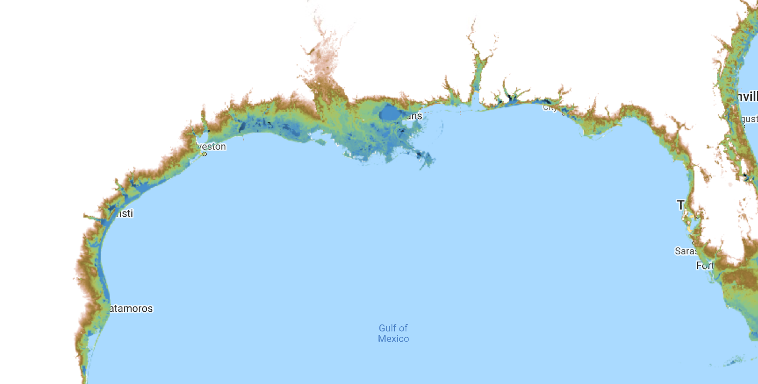
DEM

Slide 3
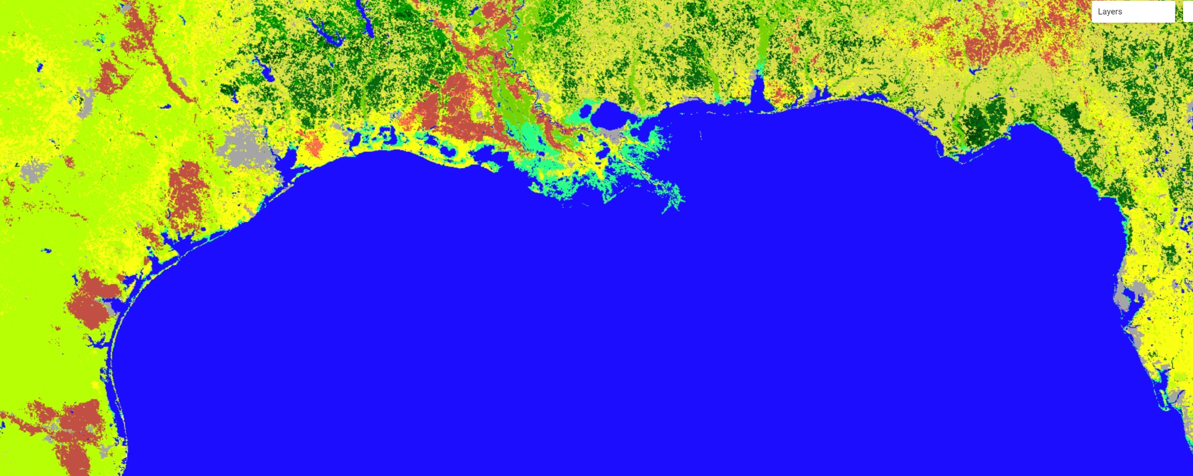
MODIS land cover

Slide 4
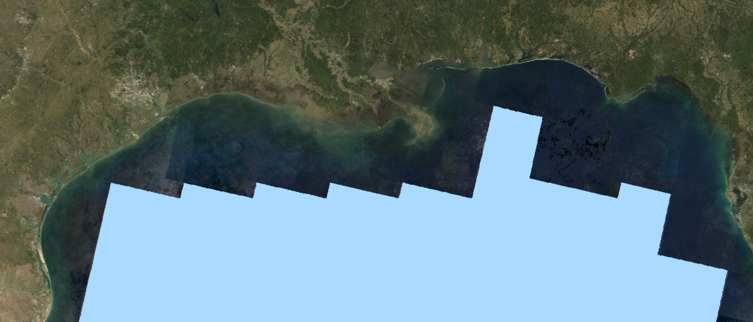
LandSat

Slide 5
Binary delta-no delta map?

Slide 6
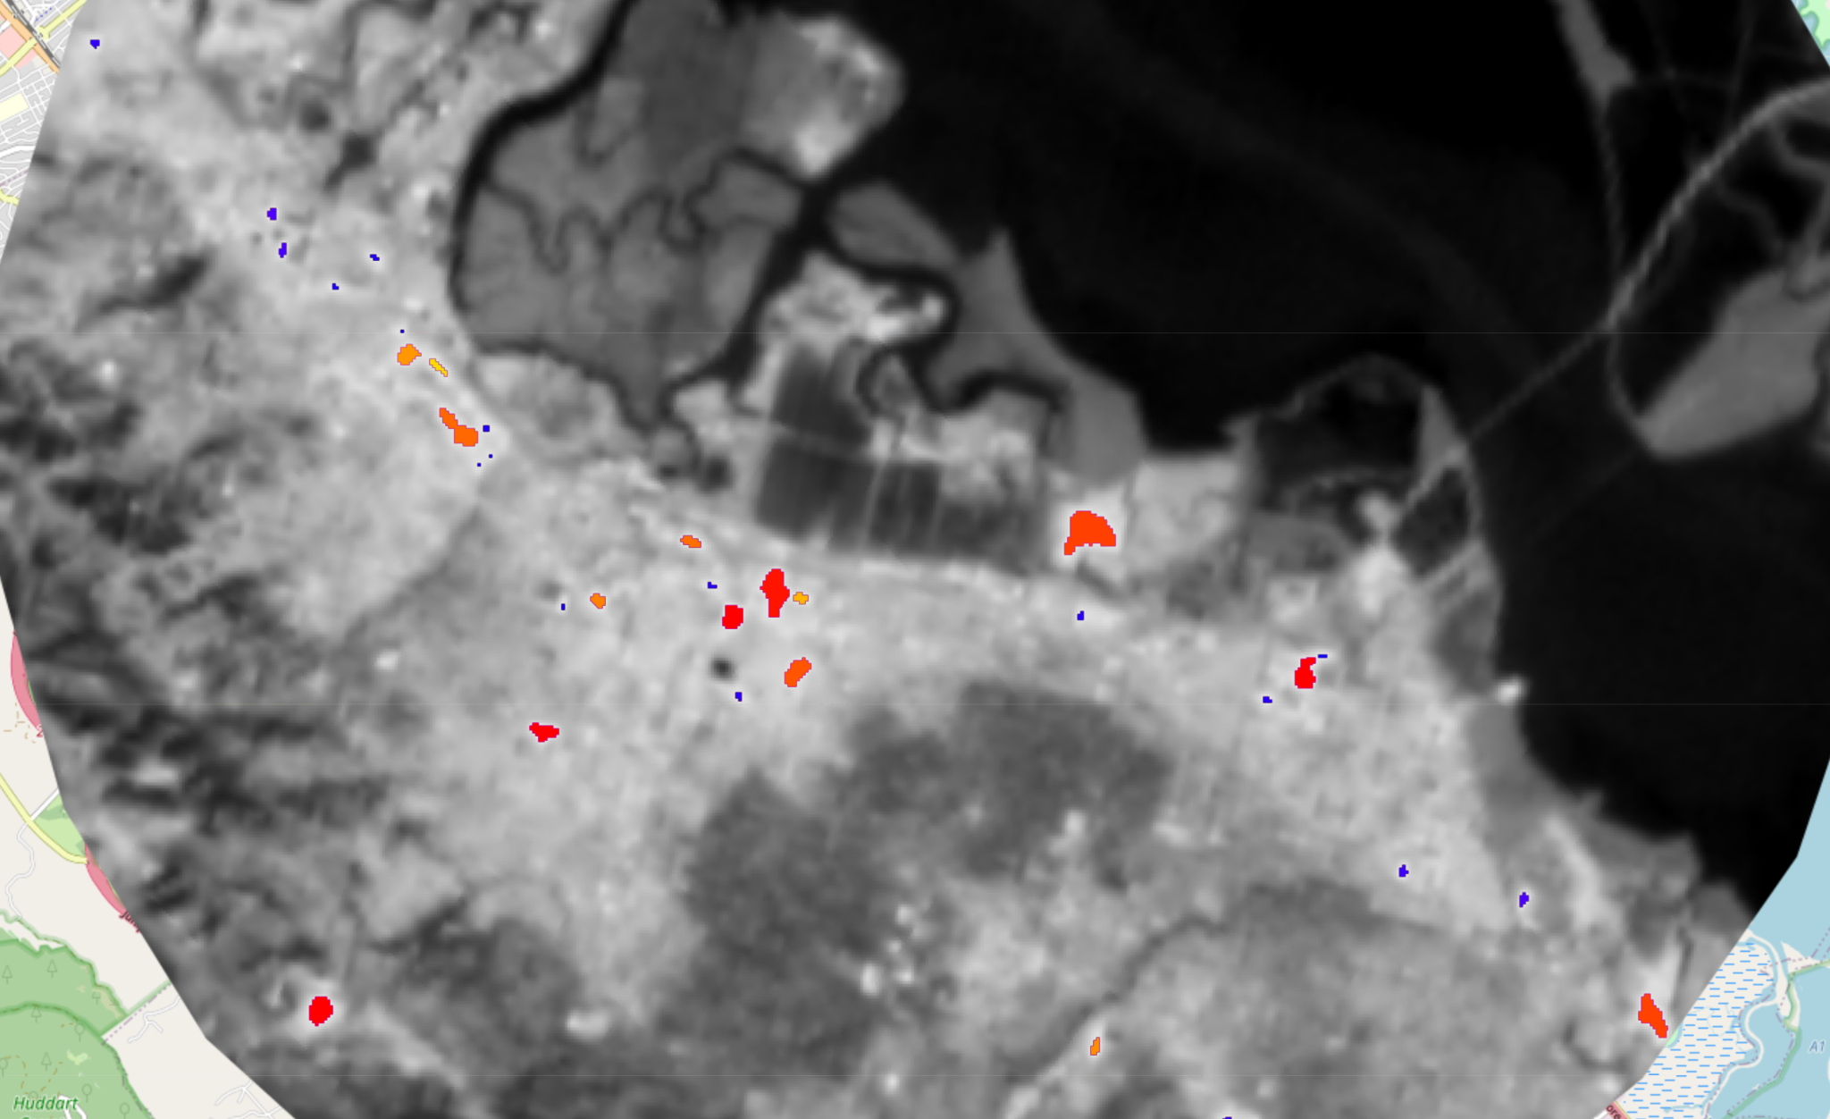
Turning binary delta classification into delta objects

Slide 7
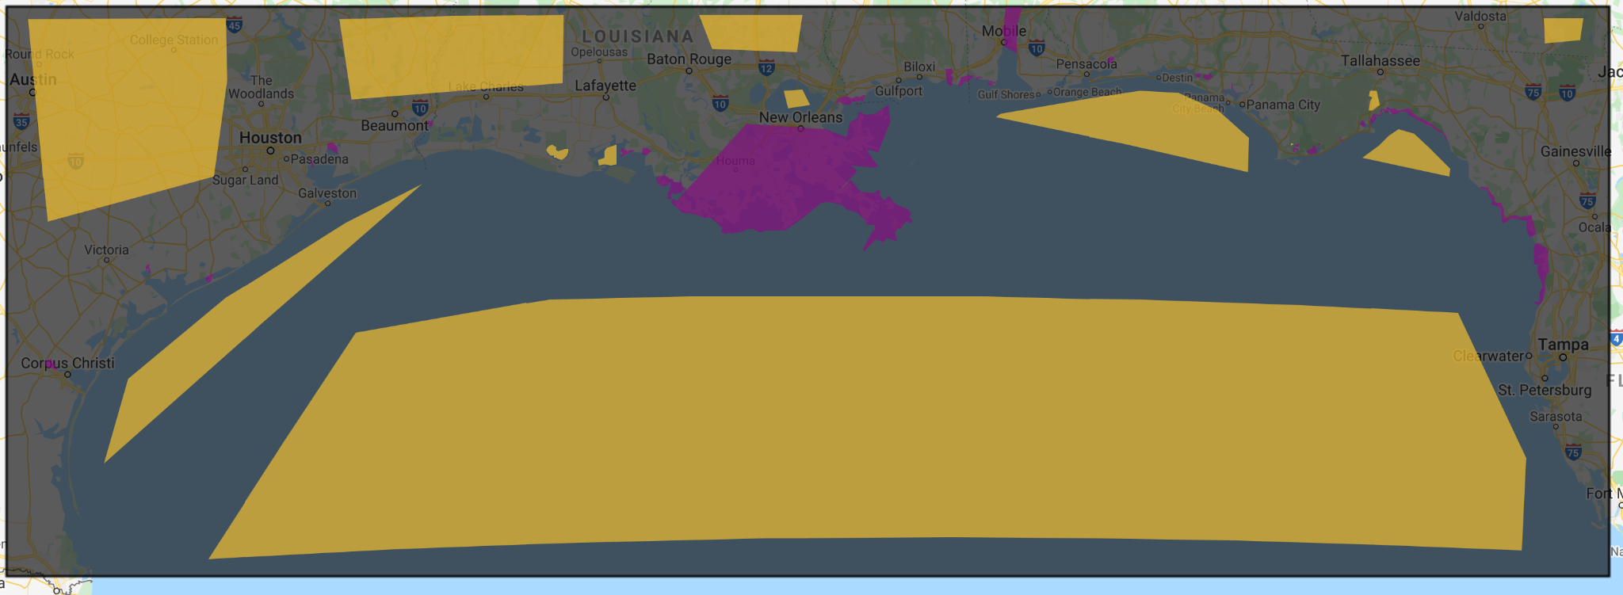
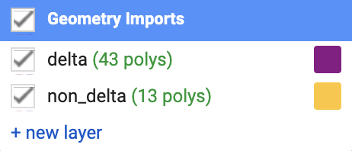
Training dataset

Slide 8
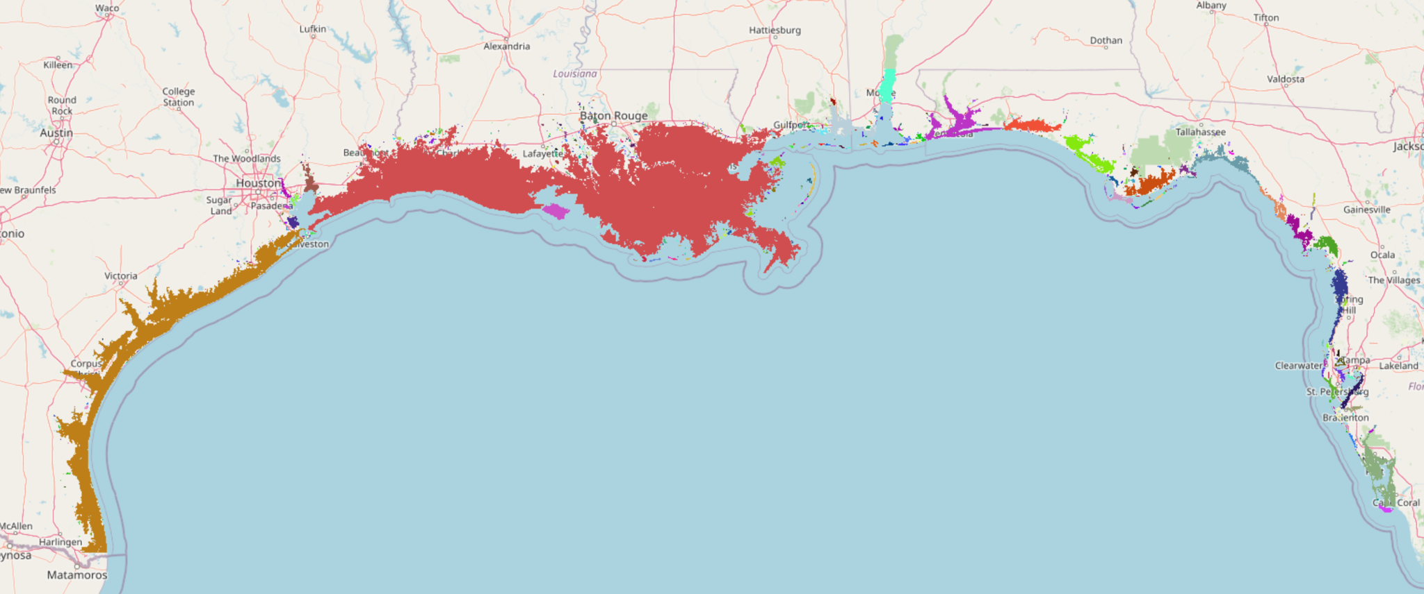
Connected components

Slide 9
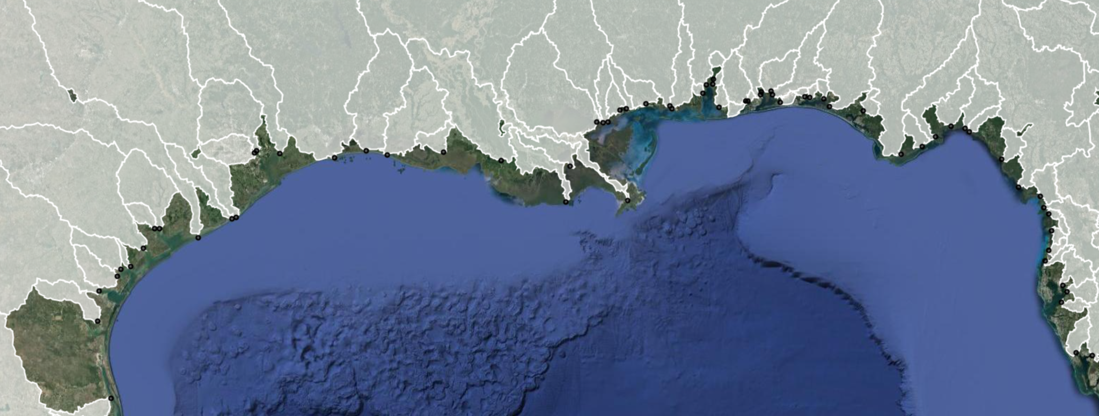
Next step: connect to river mouths

